Slide 1
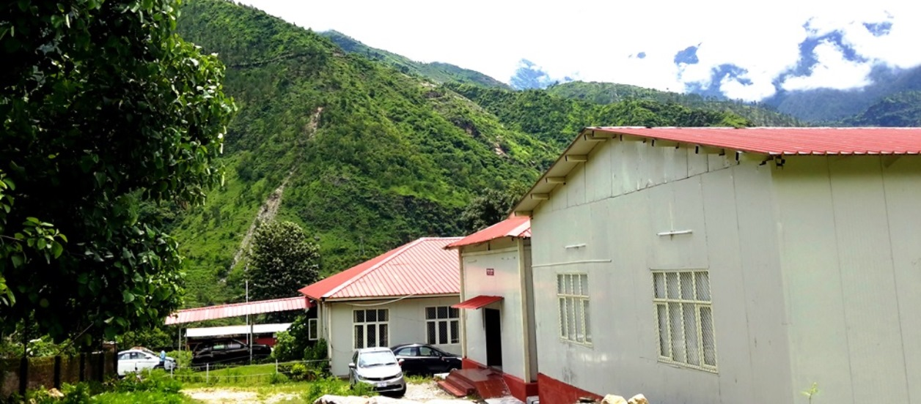
Institute of technology , Gopeshwar
(A constituent Institute of Uttarakhand Technical University)
Approved by AICTE, Ministry of HRD

Slide 2
ABOUT ITG
Established in October 2013 with the approval of Uttarakhand Government.
The college is situated at kothiyalsain in district Chamoli Uttarakhand which is 3 km from chamoli.
The academic session 2013-14 was started from 1st Oct., 2013.
The inauguration of college was done by former chief minister Mr. Vijay Bahuguana on dated 9 January, 2014.
ITG is approved by AICTE in 2015.

Slide 3
OUR MISSION
To produce quality manpower equipped with such human and social values required integrate excellent technical skills, leadership, creativity and innovation for the benefit of mankind, for sustainable development of State of Uttarakhand and to promote research in the emerging discipline.
OUR VISION
To develop into a systematic leader and pivot for excellence in technical education sector in the state, and catalyzing absorption, innovation, diffusion and transfer of high technology for improved productivity, quality of life and empowerment, thereby affecting regional growth in the State of Uttarakhand.

Slide 4
Why ITG
Knowledge Capital
The excellent mix of qualified faculty and up-to-date course contents ensure that ITG graduates are well prepared to face any challenge posed by today’s scenario.
Selection Process
The students have excellent educational background. They have been selected for admission in the college through the stringent admission test conducted by JEE Mains by IIT’s.
Practical Exposure
ITG believes in the importance of giving its students extensive practical exposure alongside invaluable academic inputs to ensure their holistic development. This ensures a perfect mix of technical acumen and academic intellect. Such exposure is provided by means of Summer Internship, Workshops, Field Visits, Industry Visits, Guest Lectures, and Live Projects. A four week compulsory Summer Internship provides an opportunity for students to apply academic knowledge to real time technology related problems. Guest lectures provide students with a chance to interact with representatives of the technical world and learn about the latest technology.

Slide 5
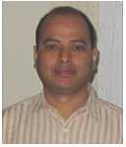
DIRECTOR, IT Gopeshwar
Dr. K.K.S.Mer joined as Director of Institute of Technology, Gopeshwar on 13/02/2015.
Prior to his present assignment he was Head of Department of Mechanical Engineering at Govind Ballabh Pant Engineering College, Ghurdauri, Pauri Garhwal.
Dr. K.K.S.Mer has graduated in Mechanical Engineering from College of Technology, PantNagar in 1993, Post Graduation in Design of Process Machines from MNREC, Allahabad in 1995 and obtained his Doctoral Degree from IIT Roorkee in 2008.
At G.B.P.E.C. Ghurdauri, Pauri Garhwal, Uttarakhand he held administrative responsibilities as:
Dean Student Welfare
Nodal Officer Institute Industry Interaction Cell
Training and Placement Officer
Chief Warden & Proctor
He trained Officers at Uttarakhand Jal Vidut Nigam Kalagarh about materials & maintenance for different parts of pumps.
He is also a member of Board of Studies of Uttarakhand Technical University.

Slide 6
COURSES OFFERED
ITG offers B.Tech Programmes in five branches namely:
S.No. | Programmes Name | Intake | Lateral Entry ( After Diploma)
1. | B.Tech in Computer Science and Engineering | 60 | 12
2. | B.Tech in Electrical Engineering | 60 | 12
3. | B.Tech in Electronics & Communication Engineering | 60 | 12
4. | B.Tech in Mechanical Engineering | 60 | 12
5. | B.Tech in Civil Engineering | 60 | 12

Slide 7
GROWTH INTAKE AT A GLANCE
In 4th year (2016-17)
Civil Engg. | 62
Computer science & Engg. | 18
Electronics & communication Engg. | 17
Electrical Engg. | 37
Mechanical Engg. | 55
In 3rd year (2016-17)
Civil Engg. | 60
Computer science & Engg. | 31
Electronics & communication Engg. | 18
Electrical Engg. | 35
Mechanical Engg. | 52

Slide 8
GROWTH INTAKE AT A GLANCE Cont.
In 2nd year (2016-17)
Civil Engg. | 56
Computer science & Engg. | 16
Electronics & communication Engg. | 04
Electrical Engg. | 15
Mechanical Engg. | 37
In 1st year (2016-17)
Civil Engg. | 64
Computer science & Engg. | 37
Electronics & communication Engg. | 15
Electrical Engg. | 29
Mechanical Engg. | 45
Total no. of students | 703

Slide 9
OUR ESTEEMED FACULTY
Name of department | Faculity | Qualification
Applied Science and humanities | Dr. Ajay Gairola(H.O.D) Ms. Indu Patni | Phd.(Mathematics),MSc Pursing Phd (UTU), MBA
Civil Engg. | Mr. Abhinav Rawat Mr. Amit Chauhan Mr. Ved Prakash Mr. Sumit Juyal | M.Tech, B.Tech B.Tech B.Tech B.Tech
Computer science & Engg. | Mr. Jitendra Singh Rauthan (H.O.D) Miss Bharti Kalra Mr. Pawan Kumar | Pursing Phd (UTU), M.Tech, B.Tech Pursing Phd (NIU), M.Tech, B.Tech Pursing Phd (UTU), M.Tech, B.Tech
Electronics and communication Engg. | Mr . Vishwanath Bijalwan(H.O.D) Mr. Arun Uniyal Mr. Arvind Kumar Ms. Meenu Chinwan Mr. Pramod Benjwal | M.Tech, B.Tech Pursing Phd (UTU), M.Tech, B.Tech M.Tech, B.Tech M.Tech, B.Tech Pursing Phd (UTU), M.Tech, B.Tech
Electrical Engg | Mr. Ombeer Saini( H.O.D) Mr. Abhishek Chauhan Mr. Abhishek Aggarwal | M.Tech, B.Tech Pursing Phd (Tha. Uni.), M.Tech, B.Tech M.Tech, B.Tech
Mechanical Engg. | Mr. Sandeep Kandwal (H.O.D) Mr. Hemant chauhan Mr. Dinesh Chauhan Mr. Arun Negi | M.Tech, B.Tech M.Tech, B.Tech Pursing Phd (UTU), M.Tech, B.Tech M.Tech, B.Tech

Slide 10
Faculty Research Publications & Citations
Name Of the Faculty | Total Research publication | Conference /workshop | Referred Journal | Citation
Vishwanath Bijalwan | 14 | 6 | 10 | 102
Jitendra Rauthan | 10 | 07 | 05 | 25
Sandeep Kandwal | 04 | 01 | - | -
Pramod Benjwal | 09 | - | - | -
Dinesh Chauhan | 06 | - | - | -
Ombeer Saini | 05 | 03 | 02 | -
Indu Patni | 03 | 02 | 01 | -
Arun uniyal | 05 | 01 | 04 | -
Arvind Kumar | 06 | 01 | 05 | -
Abhishek Aggarwal | 04 | 02 | 01 | -
Abhishek Chauhan | 07 | 05 | 02 | -
Meenu chinwan | 03 |  | 02 | -
Sriyak Yadav | 03 | 02 | 1 | -
Ajay Gairola | 05 | 13 | 05 | -
Hemant chauhan | 04 | 01 | 03 | -
Pawan Kumar | 02 | - | 02 | -
Bharti Kalra | 06 | 03 | 03 | -

Slide 11
Infrastructure
LAND AREA | 14 acres
TOTAL BUILT- UP AREA | 27,000 Sq.mt
CLASS ROOMS | 15
SEMINAR HALLS | 4
DRAWING HALLS | 2
AUDITORIUM | 1
LIBRARY | 1
READING ROOM | 2
COMPUTER LABS | 3
LABORATORIES | 15
WORKSHOPS | 1
GIRLS WAITING ROOM | 1
BOYS WAITING ROOM | 1
TUTORIAL ROOMS | 4
CANTEEN | 1

Slide 12
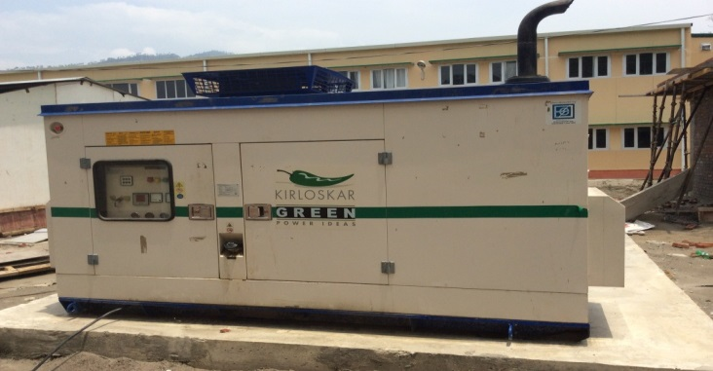
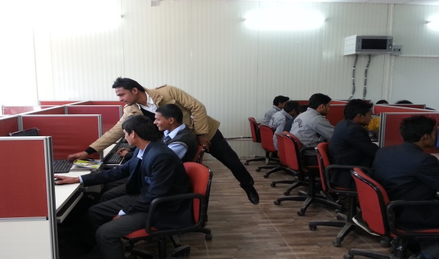
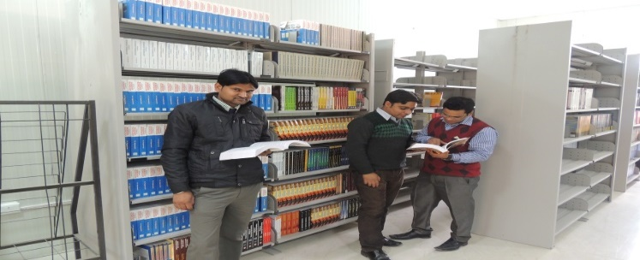
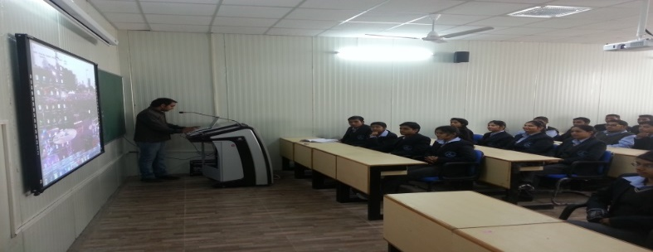
Facilities
All Labs are well Equipped
24x7 alternate power source
4 Mbps Internet Access Wi-Fi Campus Keeping you Connected
The library has open access system along with a reading room facility, Digital Library, Online Journals Access, NPTEL Lectures
Smart Classes for Interactive Learning
Language Lab
Transpiration , Medical and Canteen Facility
Auditorium
Important Facilities
Images of Facilities

Slide 13
ITG CAMPUS GLORY
Placement Records
S. No. | Name of Company | Job Profile | Package | Selected Students
1. | Jair Networks & Services Pvt.Ltd., New Delhi | Project Coordinator Trainee | 3.0L | Pankaj Pandey (ECE) Amit Negi (CSE) Shubham verma (ECE) Himanshu Bora (CSE)
2. | Acadecraft Private Limited Noida | Content Developer | 2.8L | Bhupendra Mahur (ME) Pankaj Pandey (ECE) Sumit Kathait (CSE)

Slide 14
ITG CAMPUS GLORY Cont.
IEEE technically sponsored International conference organized by ITG on 24 & 25th March 2017
National Conference was organized by ITG on 24 & 25th Oct. 2016
One Day Workshop on “ Energy Conservation” on 03 Sep. 2016
Blood donation camp on 03 Nov. 2016
Election Awareness Signature Campaign on 05 Nov. 2016
Programme on Effects of tobacco and women rights in india on 06 Dec. 2016
One day visit to Birahi Ganga Hydropower project
Village Survey: One Day Visit to “SIROUN”

Slide 15
PRESS CLIPINGS

Slide 16
FUTURE PLANS
NBA
NACC
ISO CERTIFICATION
AUTONAMOUS STATUS
MoU WITH INDUSTRIES
DST & AICTE SPONSORED PROJECTS
NATIONAL & INTERNATIONAL CONFERENCES
CONSULTANCY SERVICES

Slide 17
Thank You

