Slide 1
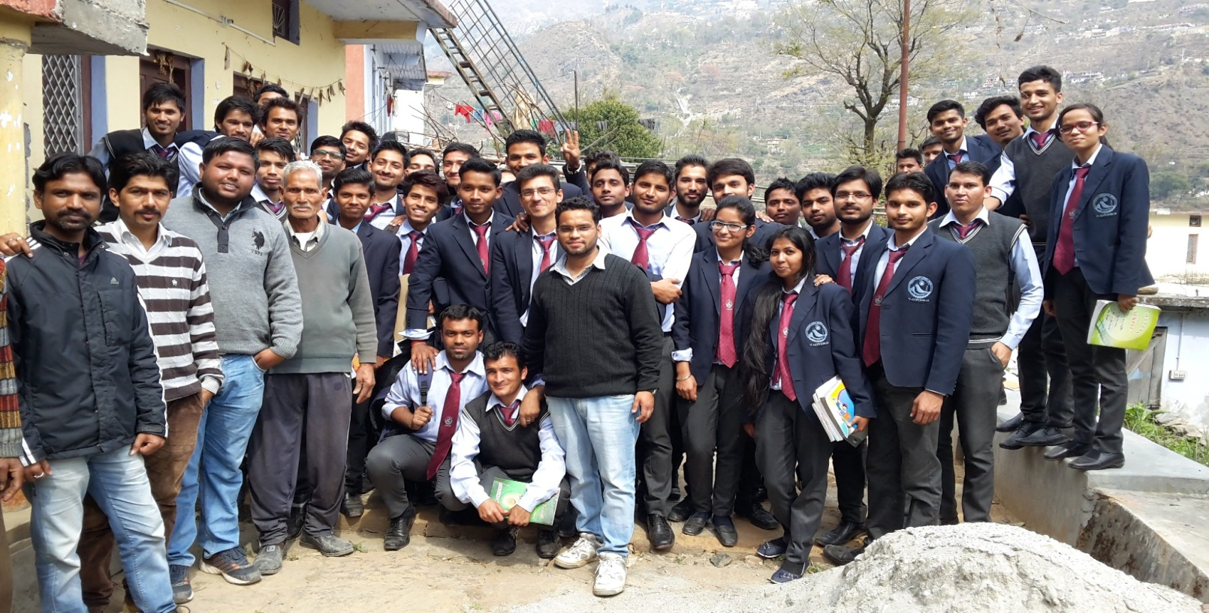
Village Survey
Presentation on one day visit to “SIROUN”
05 March 2016

Slide 2
Mechanical 3rd Year Students (Batch 2013-2017)
Group Heads
Bhupender Kumar Mahur
Ankur Chaudhary
Ashutosh Bhatt
Priyanshu Upreti
Miral Kumar Gautam
Govind Singh Negi
Aksh Adlakha
In the supervision of faculties of Mechanical Engineering Dept.
Mr. Sandeep Kandwal (H.O.D.)
Mr. Hemant Chauhan
Mr. Dinesh Kumar Chauhan
Mr. Sriyak Yadav

Slide 3
DESCRIPTION
Name :- Siroun
Block :- Dasholi
District :- Chamoli
Gram Pradhan :- Smt. Asha devi
Population(Approx.) :- 45 Families
Males -132
Females -95
Distance from our campus :- 3 Km (approx.)
Road Status :- Footpath

Slide 4
About
Siroun is a village in Chamoli district.
It is about 5 km from the main district.
It is situated uphills from the bank of tributary of Alaknanda river.
It is connected to NH 58 via a 3 km footpath along with a bridge and a 2 km road.

Slide 5
TOTAL HOUSEHOLD:- 45

Slide 6
Infrastructre
Infrastructure | Availability
Primary Health Centre | No
Primary School | Yes
High School | No
Drinking Water Supply | Yes
Electricity | Yes
Post Office | No
Concrete Road | No
Bank | No
Ration Shop | No
Market | No

Slide 7
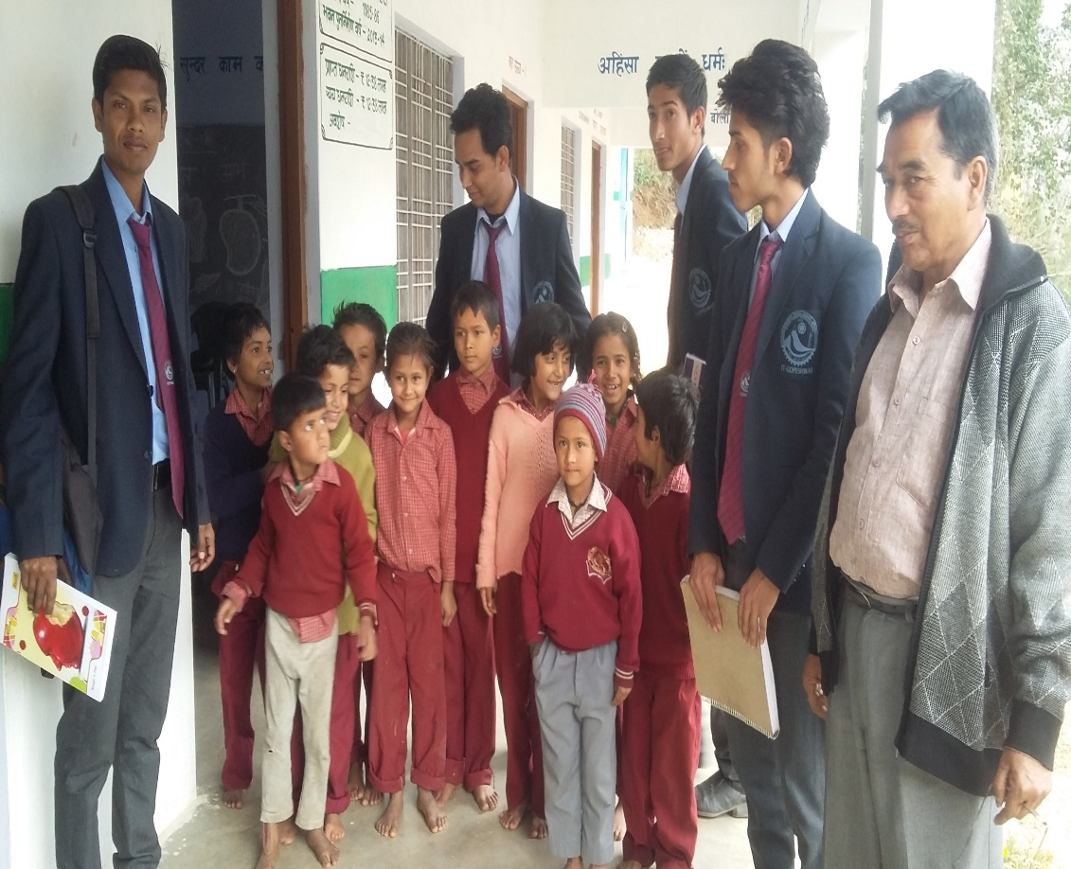
Education
Village has government primary school.
School’s infrastructure:
Concrete Building
Adequate Water Supply
Adequate Electricity
Well Sanitation Facility
Insufficient Teachers

Slide 8
EDUACTIONAL STATUS
POSITIVE | NEGATIVE
Primary schooling upto 5th class | No higher education available
Located inside the village | Small campus area
Sufficient teacher as per number of students | No playground and recreational facility
Adequate water supply | No mid day meal programme
High moral values in students | No private school/college

Slide 9
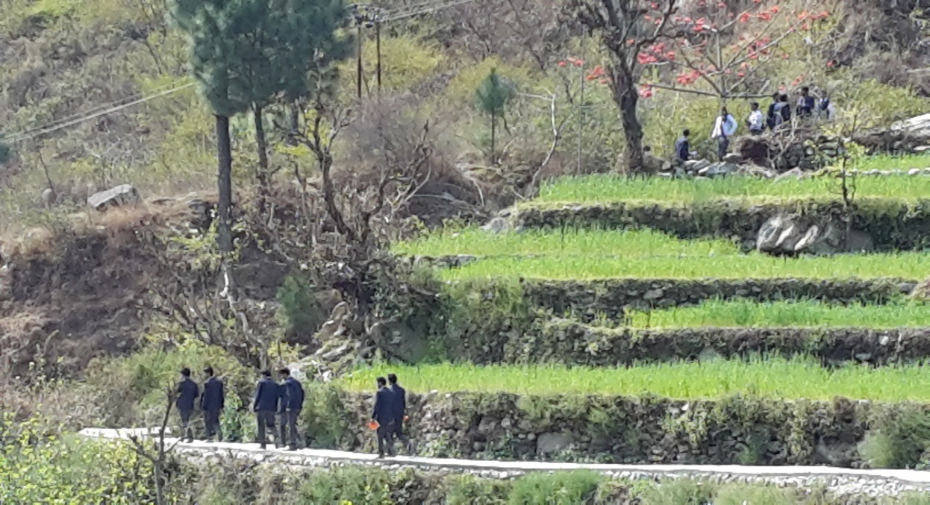
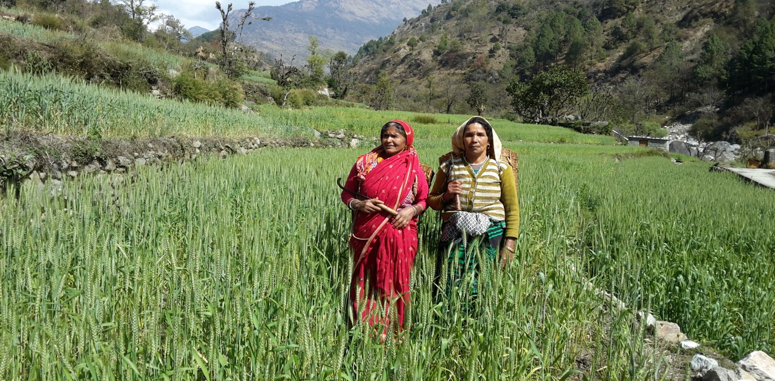
AGRICULTURE
Well fertilized land.
Main Crops Farming
Wheat
Rice
Barley
Maize
Vegetables
Potato
Tomato
Peas
Garlic
Ginger
Turmeric
Onions

Slide 10
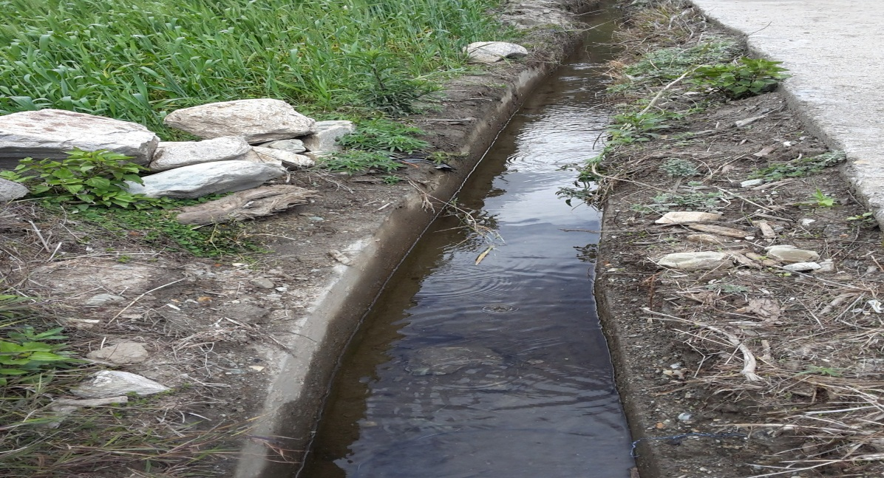
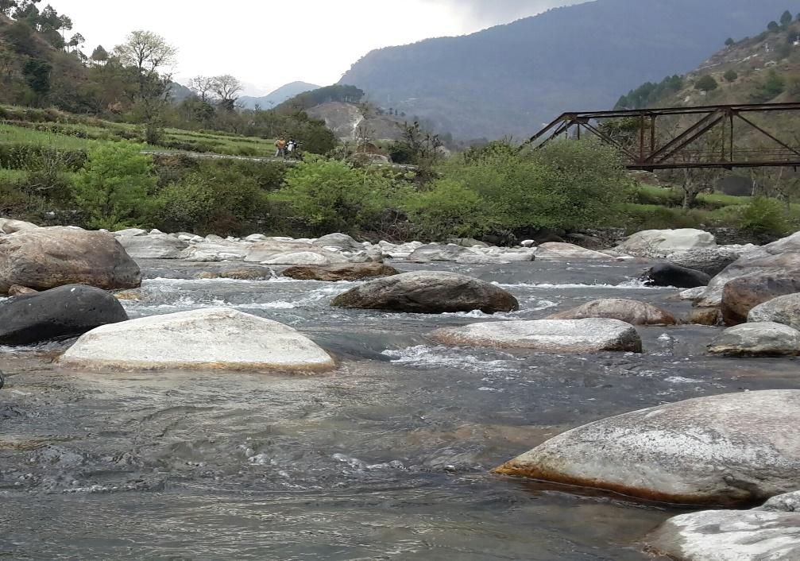
Sources of Irrigation
River water
Indigenous canals
Rain water
Agricultural aspects
Agriculture strongly dependent on Labour force.
100% Labour are from village.
No chemical fertilizers are used

Slide 11
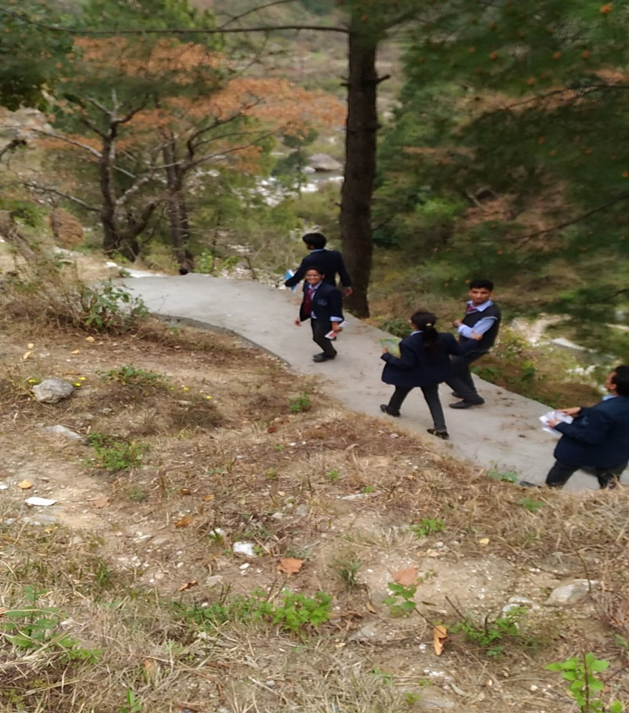
Problems
Low level of living.
No transportation.
No medical facilities.
Lack of secondary education.
No safety from wild animals.
Use of traditional tools in farming.
No hybridization in farming.

Slide 12
Lack of awareness about government policies.
Improper irrigation methods.
No street lights.
People unwilling to live in the village after job.
Improper sanitation.
Lack of knowledge about modern living standards.
Lack of knowledge to use the advance technology like they are using mortar(okhli), chakki.

Slide 13
Suggestions
Construction of road upto village must be done by the government so that people may connect directly to the commercial area.
Primary Medical Centre should be established.
Higher education must be provided in the village school.
Electric Fencing should be done around the village.
Modern tools and methods of agriculture must be employed (electric powered plough, hybrid seeds, aged cowdung).
Awareness campaign must be organized in frequent manner.

Slide 14
Use of pumps and sprinklers to provide proper water supply in the fields.
Lighting must be done along the street so that people can go even at night with ease.
Motivate people to live in the village and work for its development.
Sewer lines should be laid for proper sanitation.
Modern technologies like electric motor and thresher should be used for faster and efficient grinding and threshing.
As there is a plenty of cowdung, a biogas plant can be setup for the convenient gas supply for household use.

Slide 15
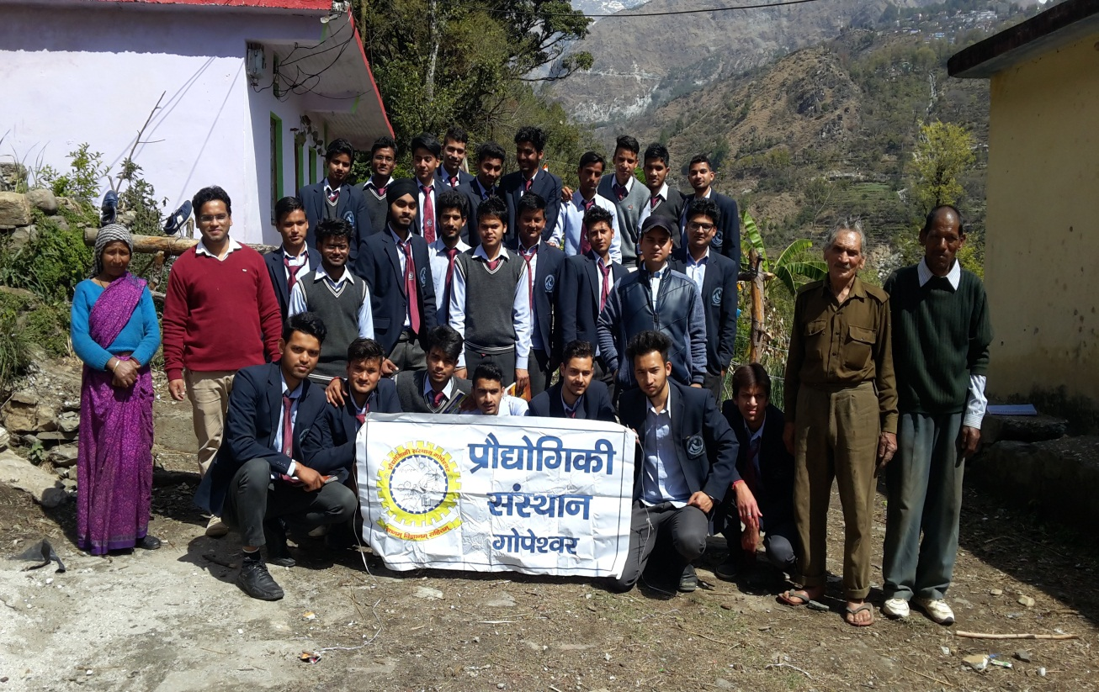
After one year Village Survey
Mechanical Engineering student (Batch 2014-2018) and faculties of mechanical department to visit Siroun village.
11 April 2017

Slide 16
Mechanical 3rd Year Students (Batch 2014-2018)
Group Heads Nitish Srivastava Subham Nautiyal
Akhilesh Rangarh Nitin Rawat
Naveen Rawat
Lokesh Kandpal
In the supervision of faculties of Mechanical Engineering Dept. Mr. Sandeep Kandwal (H.O.D.) Mr. Hemant Chauhan Mr. Dinesh Kumar Chauhan Mr. Arun negi

Slide 17
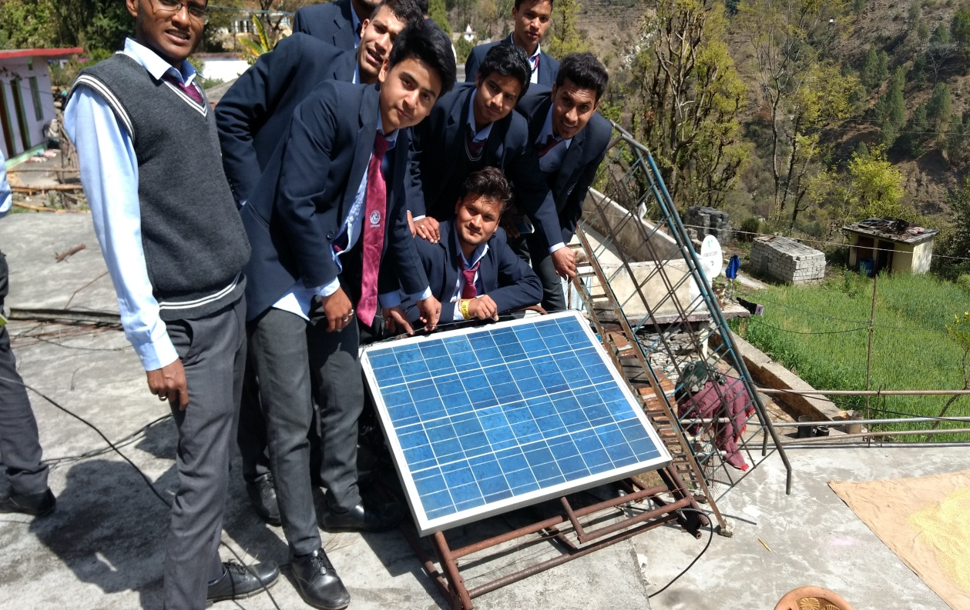
After one year of village survey team find villagers are more aware than before in every field which our team discussed last year. Which are following…..
Solar Energy
Villagers using Solar energy to Lighting Electric Bulb, LED, street bulb in night.
also using solar to cooking food.
Panels are installed by UREDA
90% of cost is beard by the UREDA for installation of solar panel

Slide 18
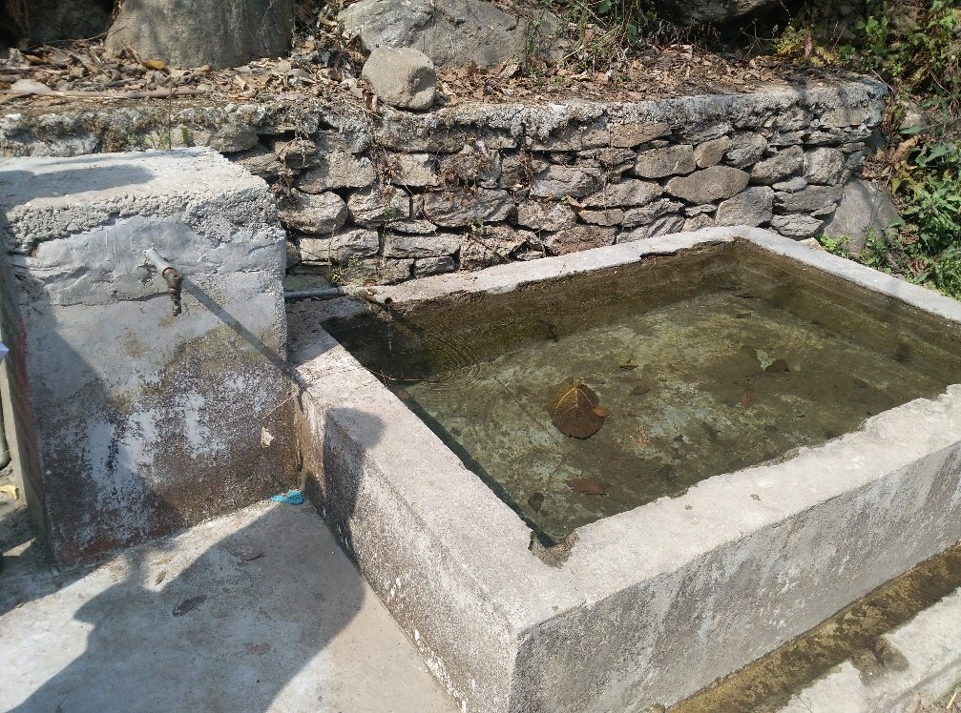
Water Harvesting
It is very difficult to provide the water from the river to the agriculture field.
So the rain water storage and using it for agriculture is the only effectively solution for better crop production.
Villagers harvest rain water in a pond and use it as drinking water for Animal. and agriculture
After one year of visit, we found that villagers are not carrying water from the river which is 1 km far away in hill areas, resulting in reducing the effort of the people.

Slide 19
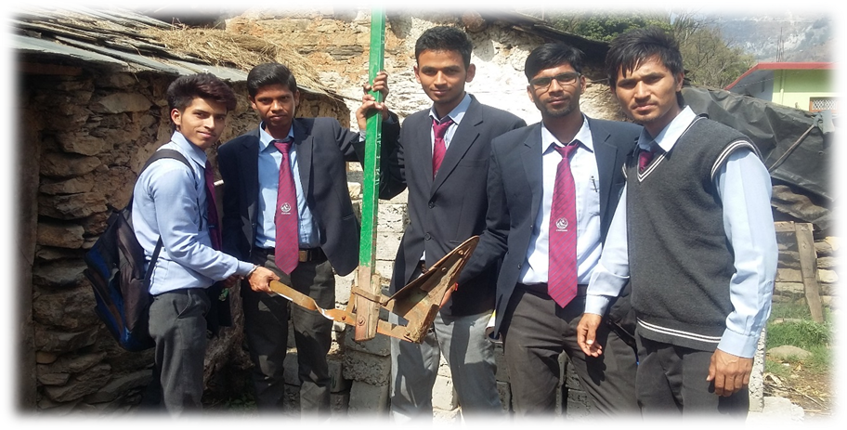
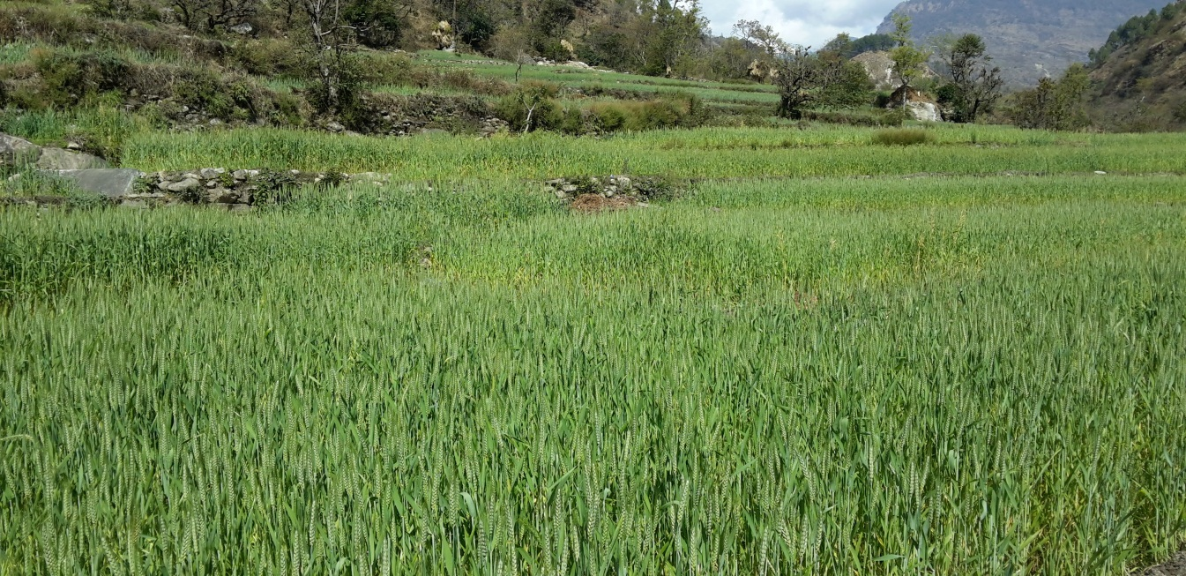
Agriculture
After one year, we found that villagers are using hybrid seeds for farming, resulting in better production with less favorable condition.
As the soil in hill area is not suitable for good production but after using the hybrid seeds, farmer improve the production of crop with better quality.

Slide 20
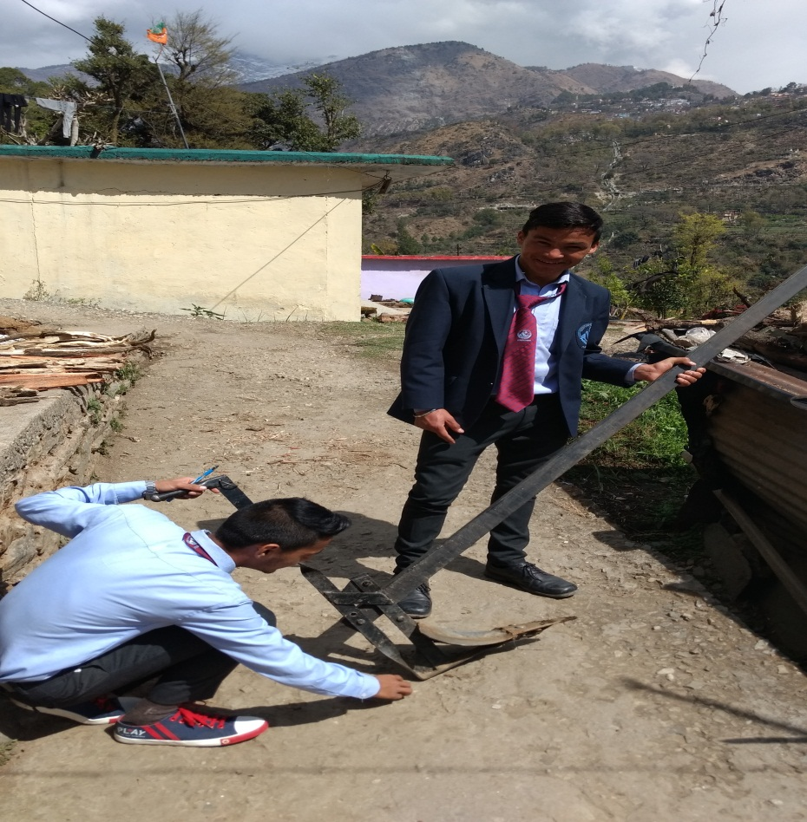
Plough with seeds pouring technology
One year before, we provide the design for plough with seeds pouring technology.
Now days they are using seeds pouring technique in plough with slight design change.
It reduces extra effort and time of seed pouring in the soil.

Slide 21
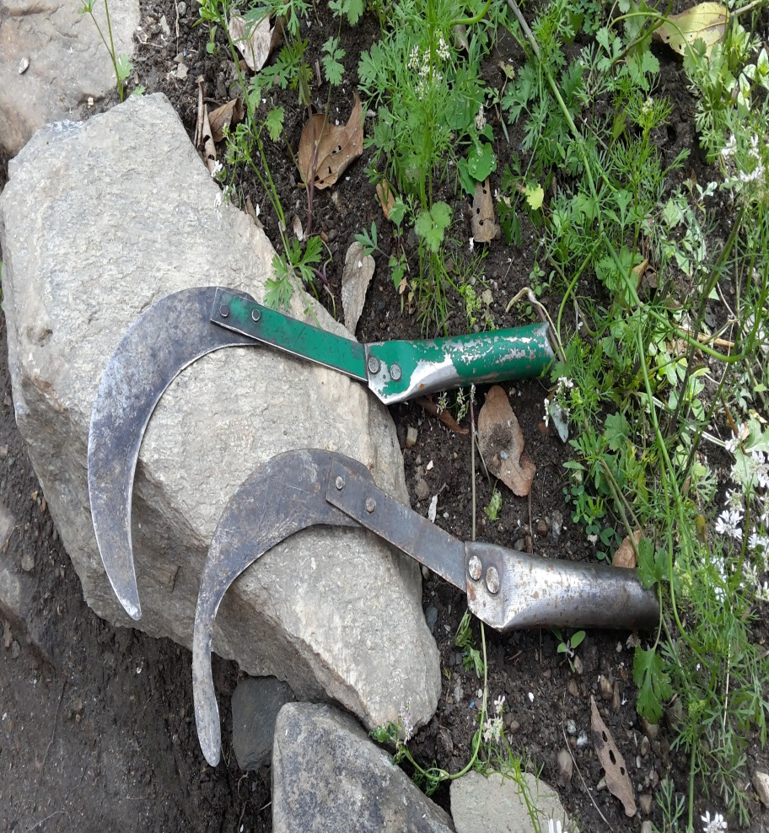
Portable husk removing tools
Last year it is suggested to the villagers to use portable husk removing machine, now we seen that the portable husk removing tools is implemented by the villagers.
This machine reduces the effort of the villagers and it is available at a subsidised rate.

Slide 22
Polly-house Agriculture
One year before, Villagers are advised to cultivate cash crop like vegetables & flowers for better life.
After one year, Some people of the village uses Polly-house technology to cultivate unseasonal vegetables with better quality and production rate to get good market price.
Government provide Subsidy to the villagers to implement the Poly-house up to 50% to promote better life to farmers.
Some NGO’s like Aajivika, Hark provides helping hand to farmer for better cultivation of crop and provide training to the farmers.

Slide 23
Presently working Projects for villagers
Presently Student and faculty team working on portable seed ploughing machine.
Portable rice planting machine for hill area fields.
And share knowledge with villagers to how we made composite for roof shade with easily available raw material in hill area.

Slide 24
Thank You

